Slide 1
Christian Morality

Slide 2
More than morality
Goal of faith is union with God.
Three aspects of religion: creed, cult, and code.
Knowing the truth, celebrating the truth, and living the truth.

Slide 3
Religious morality
Secular humanism is an ethical view that does not accept the existence of God, an immortal soul, or an afterlife. It is deficient.
Christian morality is grounded in God as the law giver, source, and standard of the good.
We need divine assistance to overcome our fallen nature and be truly good.

Slide 4
Imitation of Christ
Disciple means follower or pupil. It indicates adopting another person’s way of life.
Pauline phrases: “put on the Lord Jesus Christ,” “to be formed in Christ,” “Christ who lives in me.”
Saints give us examples of translating the life of Christ into different circumstances.

Slide 5
Interiority and actions
Not enough to do good things, but also need to be good on the inside. Intentions, mental life.
“Anyone who lusts after a woman has already committed adultery with her.”
Actions can reveal inner life: “For no good tree bears bad fruit, nor again does a bad tree bear good fruit.”

Slide 6
Positive morality
The “thou shalt nots” serve a good.
Parable of the Talents
Last judgment in Matthew 25 about a failure to do.

Slide 7
For Freedom
Following rules increases freedom.
“Whoever sins is a slave to sin.”
Freedom is the ability to do what we need to do to become our best selves. Freedom to love.
Virtue- when doing good becomes second nature.

Slide 8
All About Love
Summary of commandments: “Love God with all your heart…love your neighbor as yourself.”
Love is to want and work for the good of the other, to point of self-sacrifice.
Certain actions are not loving, regardless of intention. E.g. mercy killing, adultery.

Slide 9
Reward and punishment
Ninety New Testament passages regarding God’s punishment of evil deeds; forty refer to eternal punishment.
Reward/punishment have an intrinsic relationship to moral acts.
Chines banquet.

Slide 10
Is demanding
“Be perfect as your heavenly Father is perfect.”
“If any man would come after me, let him deny himself.”
Ask God’s help, do out best, trying again and again…. “Strive to enter the narrow gate.”

Slide 11
Christian anthropology
We have spiritual souls.
We are a unity of body and soul.
We are social beings.

Slide 12
sources
Scripture
Tradition
Natural Law: Reason’s reflection on human nature and experience as it relates to design and flourishing.
Magisterium
Conscience: Recognizing the moral quality of a specific act.

Slide 13
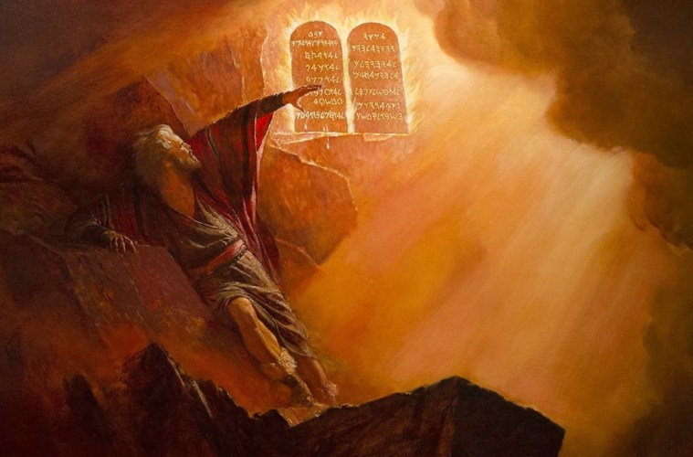
I. I am the Lord your God; you shall not have strange gods before me.

Slide 14
II. You shall not take the name of the Lord your God in vain.

Slide 15
III. Remember to keep holy the Lord’s day.

Slide 16
IV. Honor your father and your mother.

Slide 17
V. You shall not kill.

Slide 18
VI. You shall not commit adultery.

Slide 19
VII. You shall not steal.

Slide 20
VIII. You shall not bear false witness against your neighbor.

Slide 21
IX. You shall not covet your neighbor’s wife.

Slide 22
X. You shall not covet you neighbor’s goods.

Slide 23
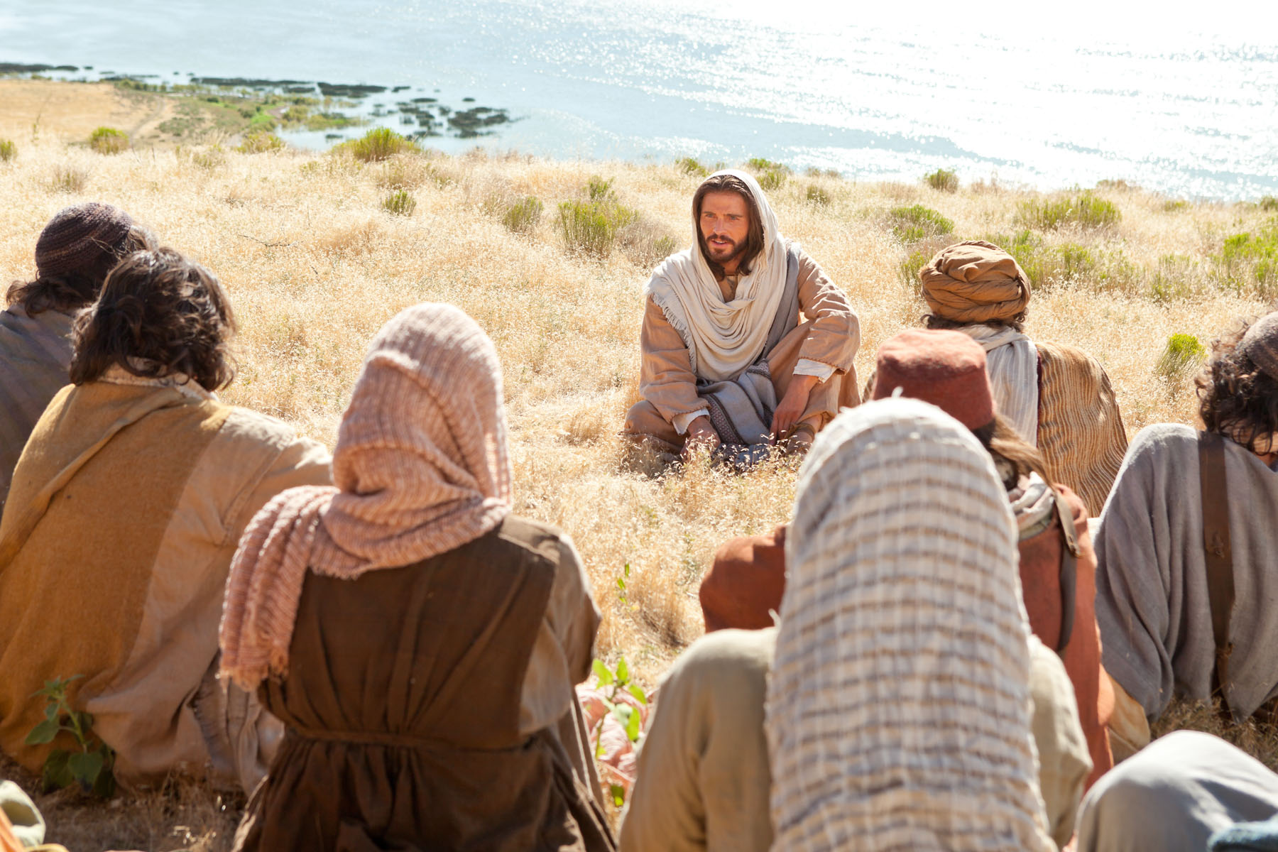
Blessed are the poor in spirit: for theirs is the kingdom of heaven.

Slide 24
Blessed are the meek: for they shall posses the land.

Slide 25
Blessed are they who mourn: for they shall be comforted.

Slide 26
Blessed are they that hunger and thirst after justice: for they shall have their fill.

Slide 27
Blessed are the merciful: for they shall obtain mercy.

Slide 28
Blessed are the clean of heart: for they shall see God.

Slide 29
Blessed are the peacemakers: for they shall be called the children of God.

Slide 30
Blessed are they that suffer persecution for justice’s sake: for theirs is the kingdom of heaven.

