Slide 1
Salvation History

Slide 2
Creation
God gives form and then fills
Creates by His Word
Man, pinnacle of creation, image and likeness of God, regent to govern
Parallels to Temple, God’s dwelling place, “to cultivate and care for it”

Slide 3
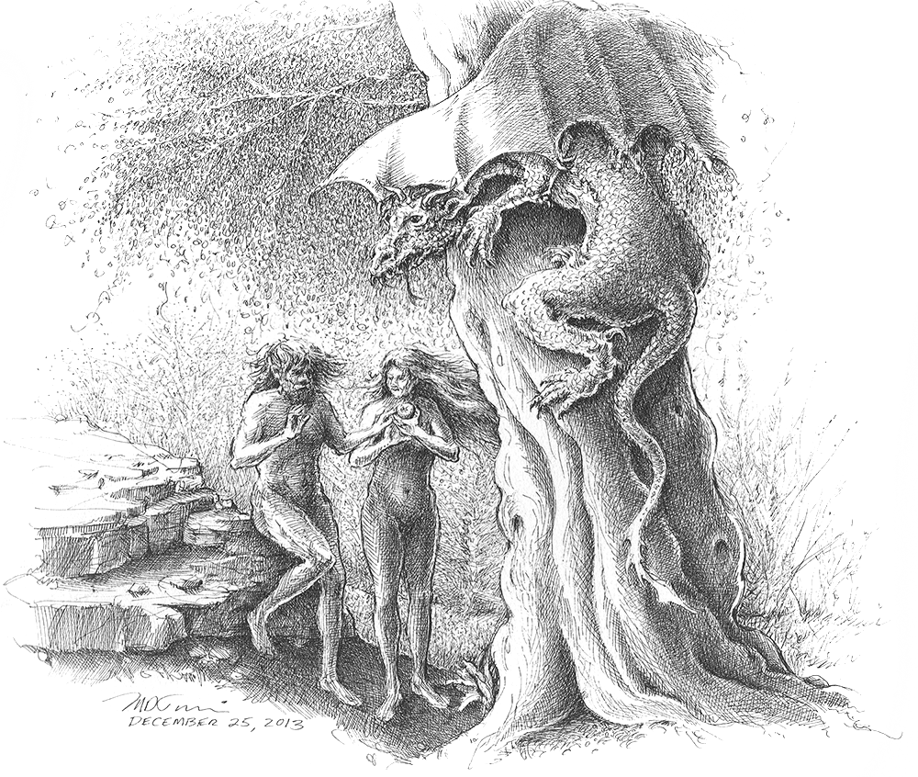
Fall
Nahash, serpent or dragon = Satan
Temptation not to trust God
Rebellion and consequences

Slide 4
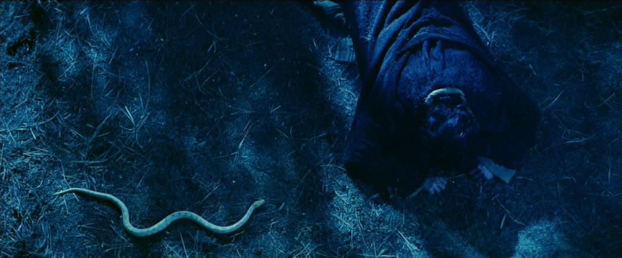
Promise - Protoevangelium
“I will put enmity between you and the woman, and between your seed and her seed; he shall bruise your head, and you shall bruise his heel.” – Gen. 3:15

Slide 5
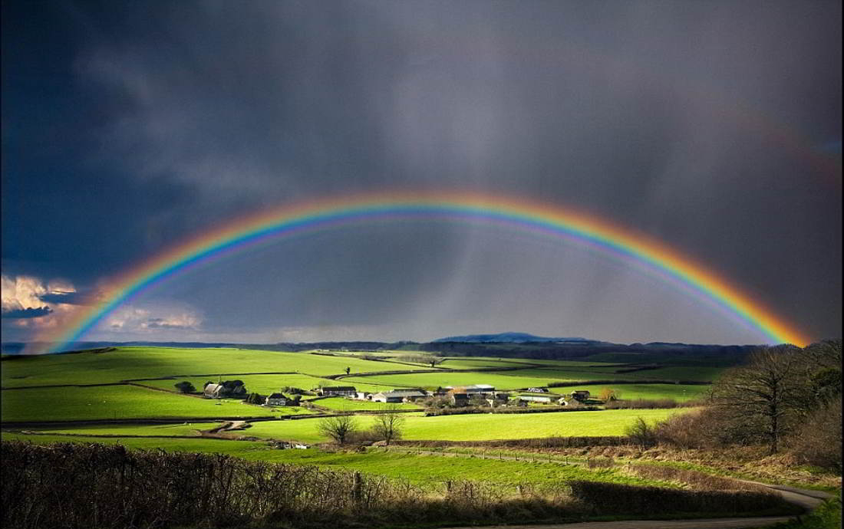
Covenant with Noah
Cain the wicked, Seth the righteous
Evil so great, need to start over
Saved through water (prefigure baptism)
Covenant sign of rainbow, sacrifice offered

Slide 6
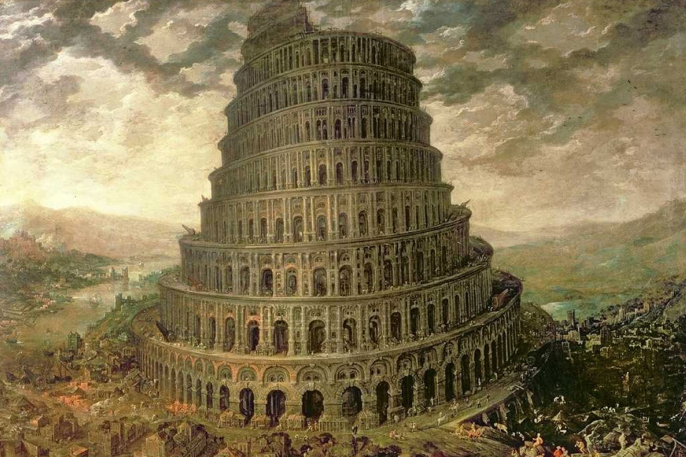
Making a Name for Themselves
Tower of Babel
Righteous glorify God’s name

Slide 7
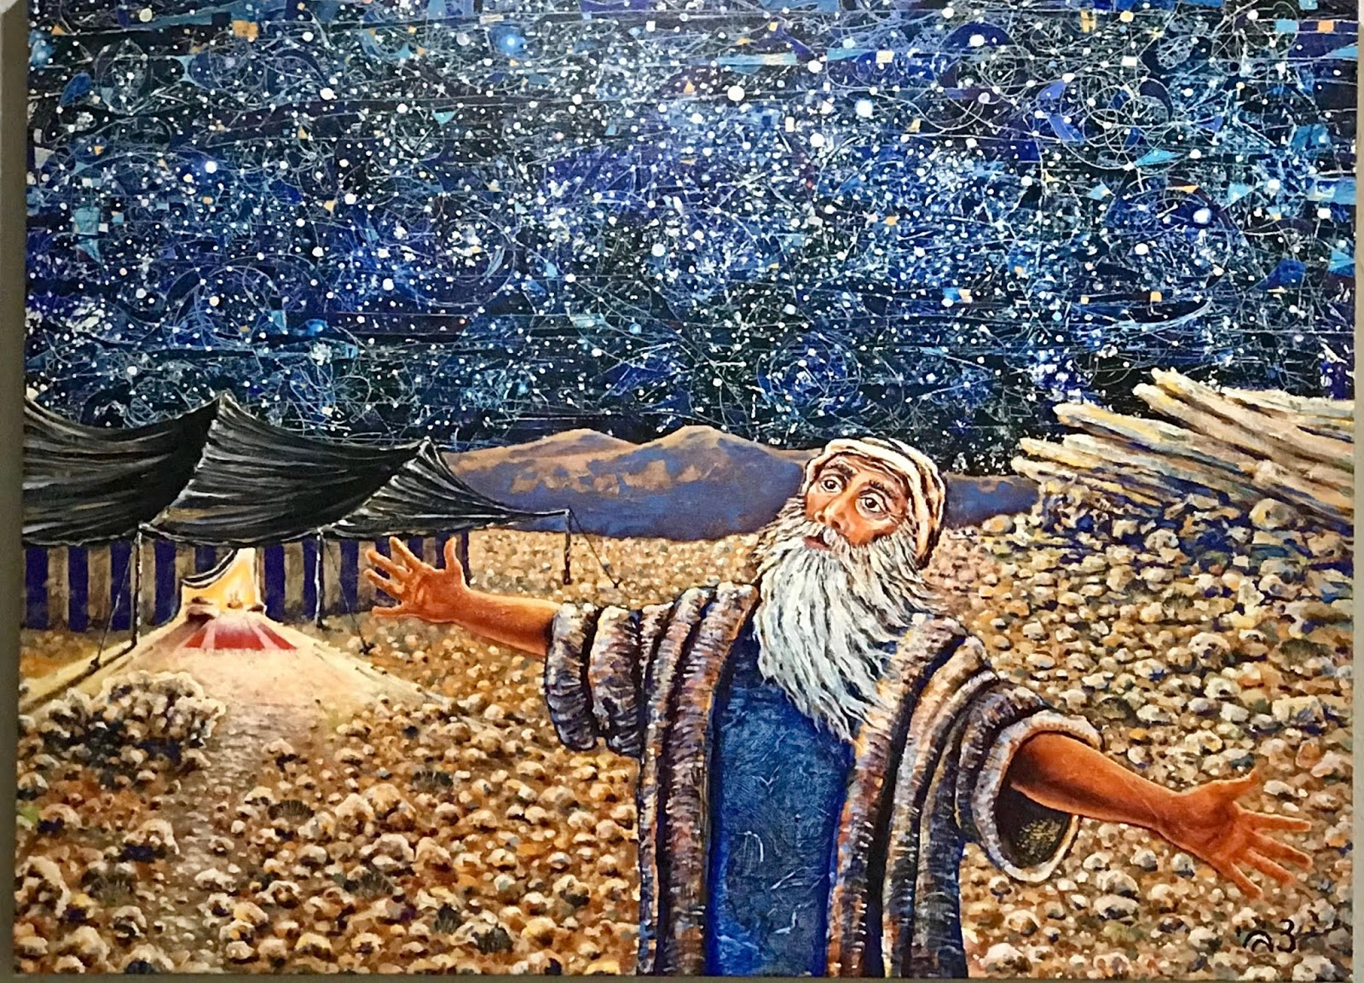
Covenant with Abram
God promises to make of Abraham a great nation with their own LAND, to give him a great name (KINGDOM), and to make him a source for BLESSING the entire world
Sign of covenant is circumcision

Slide 8
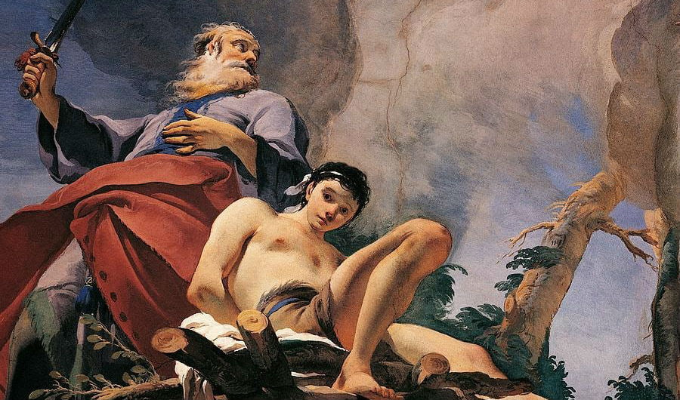
Sacrifice of Isaac
Prefiguring Christ
Isaac carries wood
Mt. Moriah, God will provide lamb for the sacrifice.

Slide 9
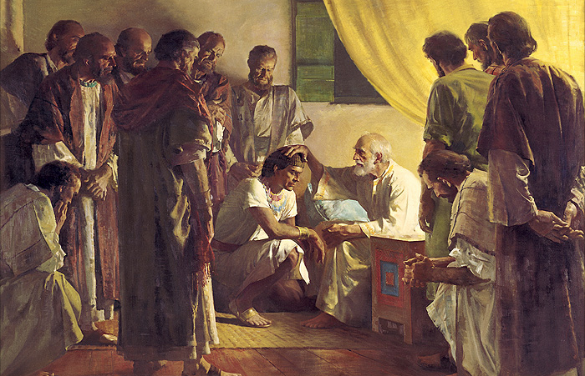
Jacob and Sons
Twelve tribes
Settle in Egypt
Promises to Judah a royal dynasty that will be everlasting

Slide 10
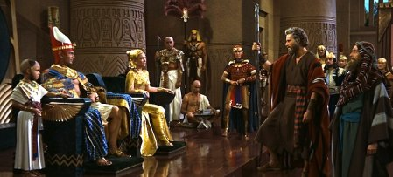
Exodus
God’s revelation and Moses’ calling
10 plagues
Passover Lamb
Set free from slavery

Slide 11
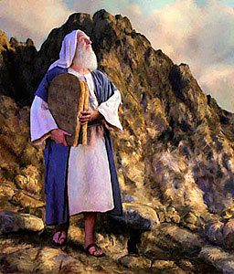
Desert Wanderings – Sinai Covenant
Time of testing, to teach Israel how to trust in God
Grumbling, manna, “Man does not live by bread alone…”
10 Commandments, sprinkling of blood
God promises to bless them, they promise to manifest God’s holiness
Covenant Curse
Golden Calf
Levitical priesthood

Slide 12
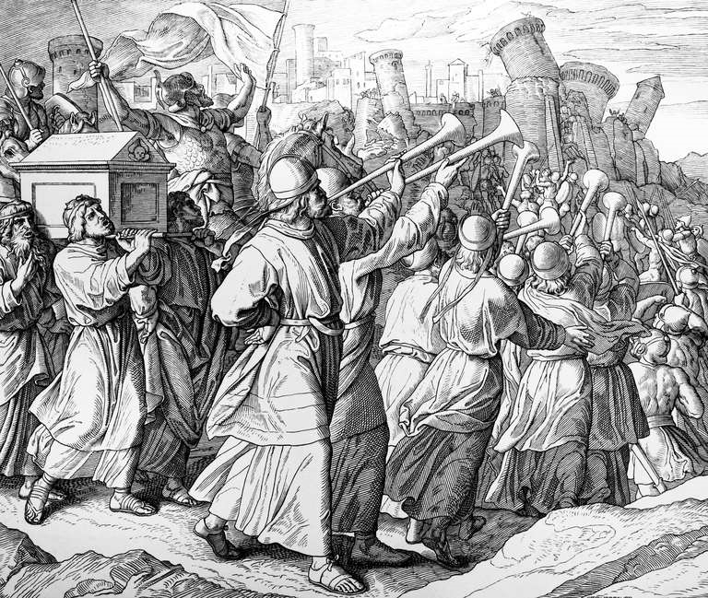
Entering the Promised Land
Joshua, successor to Moses
The non-battle of Jericho
The Ark of the Covenant

Slide 13
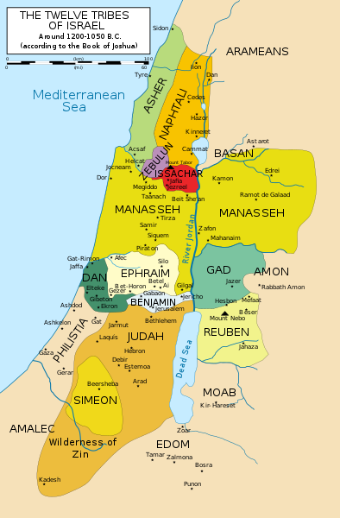
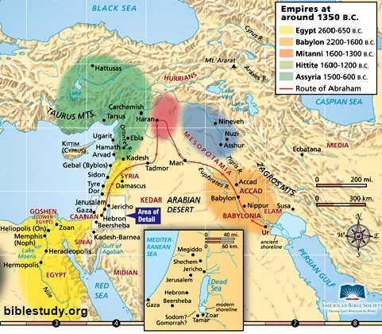
The promised land

Slide 14
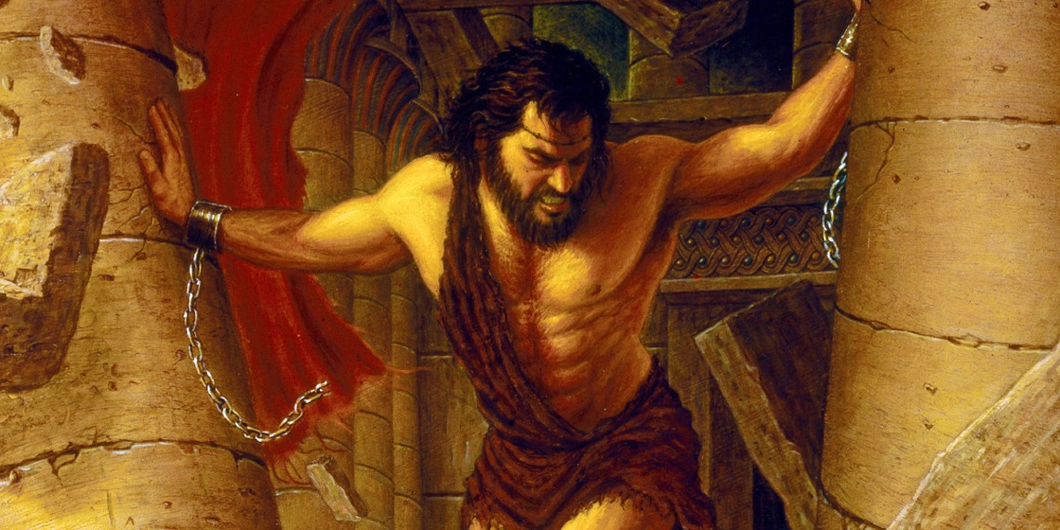
Judges
"so that through them [the pagans left in the land] He might….put Israel to the test, to determine whether they would obey the commandments the Lord had enjoined on their fathers through Moses" (see Judges 3:1,4)
Cycle of sin, punishment, repentance, salvation
Ruth, pagan woman who covenants with mother-in-law Naomi

Slide 15
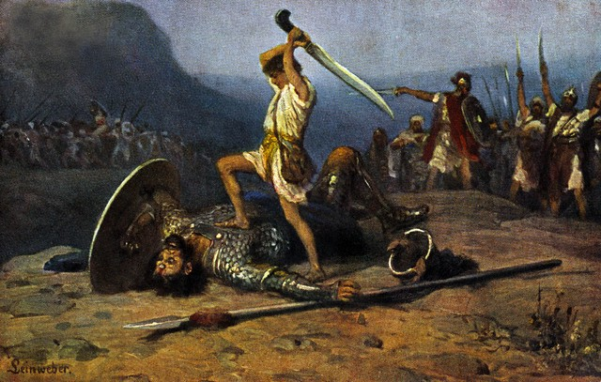
Kingdom
Prophet Samuel
People demand a king
King Saul and his fall
David, the shepherd boy, is anointed
Brave and God-fearing, “the battle is the Lord…it is not by sword or spear that the Lord saves” (see 1 Samuel 17:32-51)

Slide 16
King David (1035-970 bc)
Unites the tribes
Establishes Jerusalem as capital
Chronicles describes David as God’s ideal leader, the righteous ruler who composes psalms, leads people in worship, and teaches God’s wisdom
Symbol of the Kingdom of God
God promises to establish David’s kingdom as an everlasting kingdom, with an heir that will have an everlasting reign, and will be a son to God

Slide 17
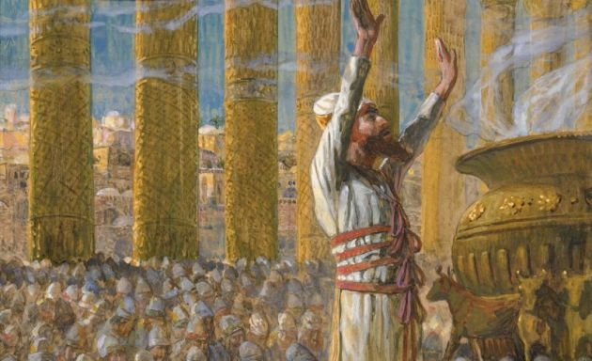
King Solomon
Renowned for wisdom
Built the temple on Mt. Moriah
Sitting at right is Queen Mother
Prime minister, Master of the Palace, who is given keys
Height of wealth and influence

Slide 18
Divided Kingdom
Sins of Solomon
During reign of Rehoboam, high taxes lead to 10 tribes of north splitting from Judah and Benjamin
North – Israel, and South—Judah
Apostasy of North, Elijah the prophet and wicked King Ahab and Queen Jezebel
Israel destroyed by Assyria in 722 B.C. stories of Esther, Judith, and Tobit

Slide 19
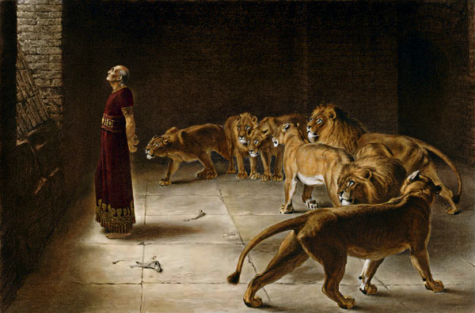
Fall of Judah and Exile
Babylon conquers Jerusalem in 597 B.C.
Jews are taken into captivity
Story of Daniel
Jeremiah’s prophecy that Exile would last 70 years
Cyrus the great of Persia sends the Jews home

Slide 20
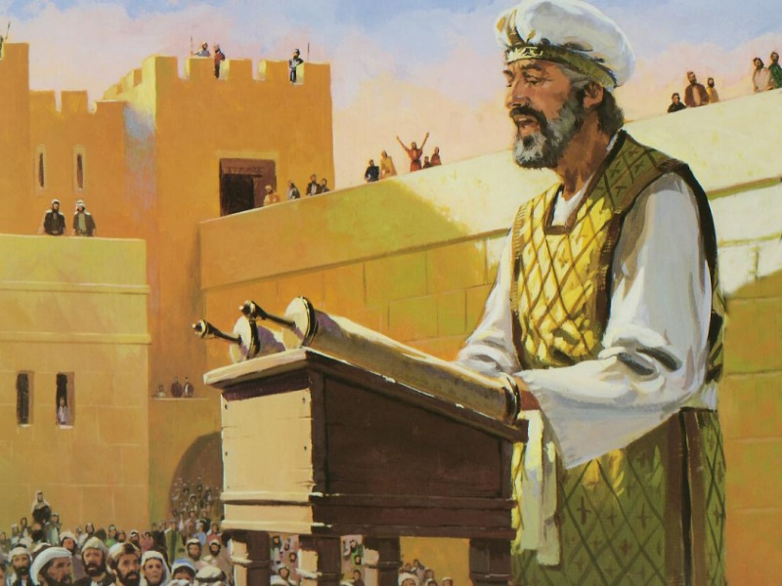
Return
Recorded in Ezra and Nehemiah
Rebuilt Temple (516 B.C.)
Ezra renews covenant
2nd Temple Period

Slide 21
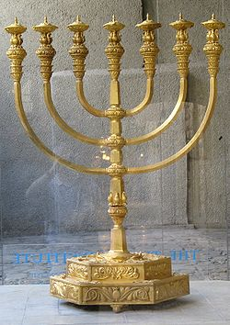
Maccabean Revolt
Alexander the Great and Hellenistic kings
Persecution and Jewish martyrs
Judas Maccabeus, rededication of temple (167 BC)
Hasmonian dynasty
Rise of Sadducees and Pharisees

Slide 22
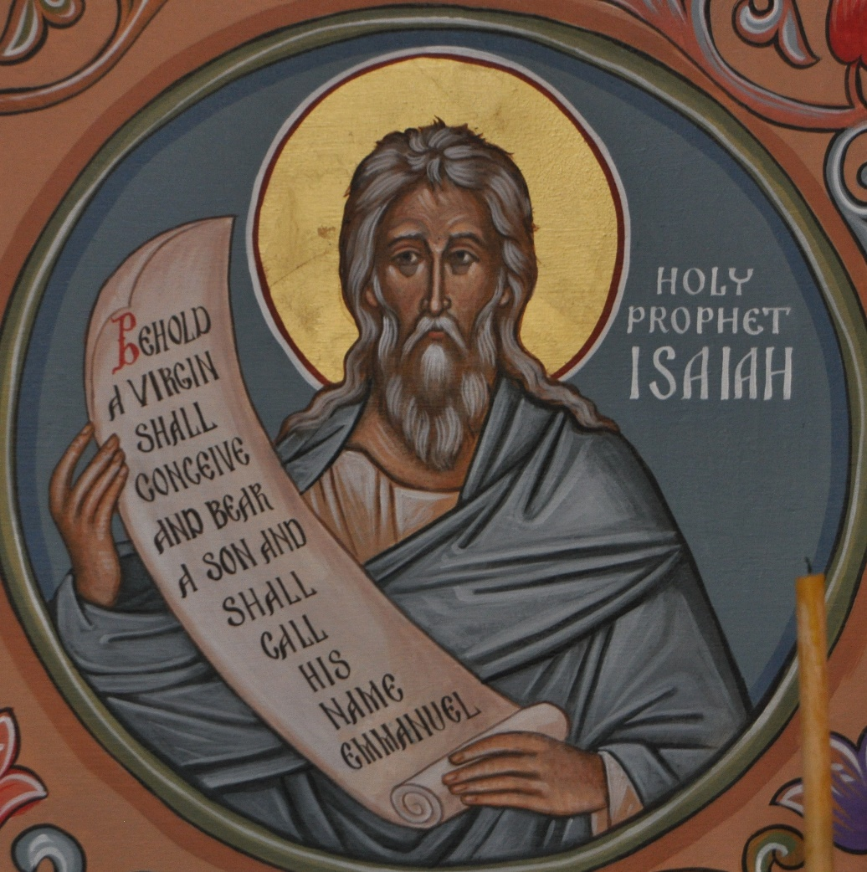
PROPHETS OF the Messiah and the New Covenant
Isaiah prophesied the coming of a son of David, a child born in the line of David, who would gather together God’s scattered people into a new kingdom that would rule the world from Zion, by the Law of God (see Isaiah 2:2-3; Amos 9:11).
Jeremiah: "The days are coming, says the Lord, when I will make a new covenant with the house of Israel and the house of Judah…I will be their God, and they shall be my people."

Slide 23
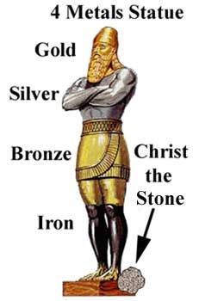
Awaiting the Messiah and the New Covenant
Daniel’s vision of the Son of Man. "He received dominion, glory and kingship - nations and peoples of every language serve him; his dominion is an everlasting dominion that shall not be taken away. His kingdom shall not be destroyed" (see Daniel 7:14).
Daniel predicts successive dominant empires and the general time period that the Messiah will come

Slide 25
Fulfillment in jesus
“The books of the genealogy of Jesus Christ, the Son of David, the son of Abraham.”
Genesis, of God Saves, the Anointed One
Worldwide Kingdom (David) and Blessing (Abraham)
Lamb of God who takes away the sins of the world
Hundreds of prophecies/allusions fulfilled in Jesus: Messiah would be born of a Virgin, in Bethlehem, ride a colt into Jerusalem, would teach in parables, be a stumbling block, begin ministry in Galilee, draw Gentiles to himself, work miracles, proclaim good news to the poor, free prisoners and the oppressed, put an end to sin, bring everlasting righteousness, be betrayed for 30 pieces of silver, suffer, die, and rise

Slide 26
Jesus the messiah
Gather the Tribes of Israel
12 apostles, New Israel, gathering Jews, lost tribes, and gentiles into the Church
Cleanse the Temple
God’s dwelling among men is the Body of Christ
Defeat Israel’s Enemies
Real enemies were sin and Satan, which Jesus defeats through death and resurrection
Rome is defeated by conversion
Reign as Lord of the Nations
International kingdom of Church, with a King that serves and gives his life as a ransom for many.

